Slide 1
A point satisfies an equation if its coordinates make the equation true (pg. 268)
x + y = 5
(1,4)
1 + 4 = 5
Satisfies
[verb]
To fulfill the desires, expectations, needs, or demands of (a person, the mind, etc.)
To make the statement true ________

Slide 2
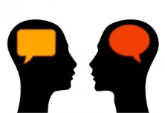
Satisfy is a verb. Satisfied is an adjective. Satisfies is plural. Satisfaction is the noun.
Imagine a time when you were satisfied by something. What makes you satisfied?
I am satisfied, when I
___________________________.

Slide 3
The graph of an equation is the collection of all points with coordinates that make the equation true. (pg. 268)
x + y = 5
(1,4),(2,3),(0,5),(1.5,3.5),(6,-1)
Collection
[noun]
A group of objects or an amount of material accumulated in one location, especially for some purpose or as a result of some process
A group of something ________

Slide 4
Collection is a cognate with colección
We collect many things. Think of one of my collections.
I have a collection of
___________________________.

Slide 5
You can test whether a coordinate pair is part of the graph of an equation by plugging the coordinates into the equation(pg. 267)
Does (2,3) make the equation true?
x + y = 5
2 + 3 = 5
5 = 5
Test
[verb]
The trial of the quality of something
Check
________

Slide 6
You can take a test. You can be tested. You can be the tester. You could be in the middle of testing.
You test things everything day. Think about the last thing that you tested.
I like to test,
___________________________.

Slide 7
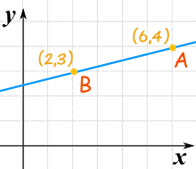
Each point that makes the equation true is on this line(pg. 267)
On the line
[Phrase]
The point is one that makes up the line and makes the equation true.
Line contains that point
________

Slide 8
On the line is a phrase. The line contains that point. It could also mean that it is in jeopardy of being lost. I put a hundred dollars on the line to win this game.
Image an event and something you would put on the line.
I would put my _______,on the line for
___________________________.

